Slide 1
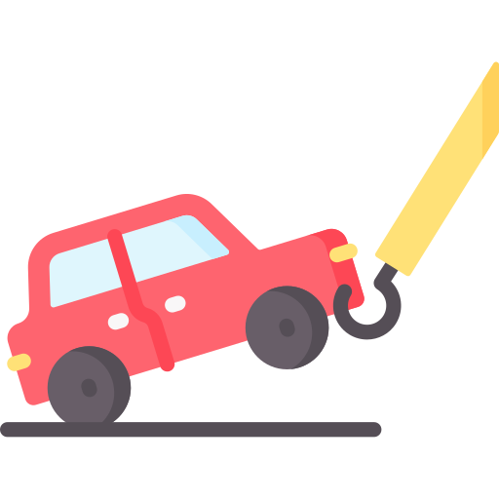

Tow Mater
Second review
+ Martin Chéliz
+ Laura Mendes
+ Samantha Gorrin
+ Alexis Pierre Dit Lambert
+ Imane El Khamlichi
+ Léonie Hatte
Notes:
LEONIE

Slide 2




Table of content
The final product
Release vision
Second release
Demonstration
Tests
Sprint evaluation
Time Schedule
Next Sprint
Demonstration
Tests
Notes:
LEONIE

Slide 3
Part 1 : The product
Notes:
LEONIE/IMANE

Slide 4
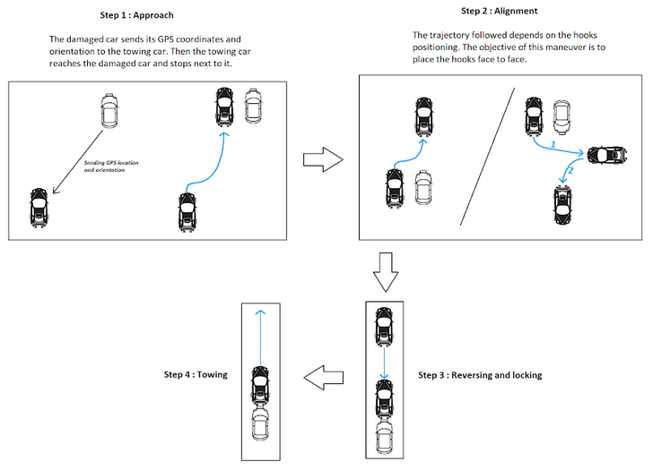
The final product
1
Sending GPS coordinates and reaching the damaged car
2
Maneuvering to place the hooks face to face
3
Reversing and locking
4
Towing
Performing the alignment maneuver and towing the car
Detecting and avoiding obstacles
Communicating with damaged car
Reaching the damaged car
Notes:
IMANE

Slide 5
Release vision
Sprint 4
Sprint 2
U-turn
Identifies moving obstacles
Stops when moving obstacles
Avoids fixed obstacles during alignment maneuver
The vehicles communicate
Reaches the damaged car
Performs the alignment
Follows a straight line
Locks the hook
Detects large obstacles
Speed regulation
No U-turn
Detects small obstacles
Identifies the car
Tows in a straight line
Sprint 1
Sprint 3
Sprint 5
Notes:
MARTIN

Slide 6
Second release
Alexis
Samantha
Léonie
Martin
Laura
Imane
15/11
22/11
29/11
Time
Higher Priority
Lower Priority
Detecting the hook of the broken car
Detecting a small obstacle
Manoeuvring to line up with the damaged vehicle
Towing the car on a straight line
Notes:
SAMANTHA

Slide 7
Part 2 : The demo
Notes:
SAMANTHA/MARTIN

Slide 8


Demonstration
Manoeuvring to line up with the damaged vehicle
Detecting a small obstacle
Detecting the hook of the broken car
Towing the car on a straight line
Notes:
MARTIN
The best slide in History
8

Slide 9
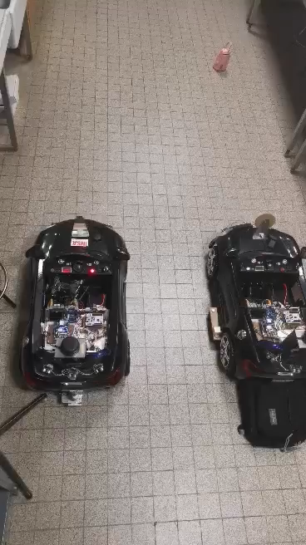
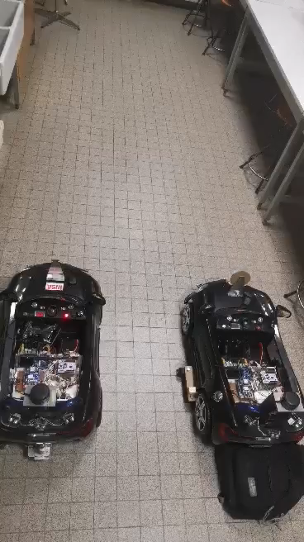
Tests (1/3)
Maneuvering without U-turn
Obstacle smaller than
30 cm
Detecting a small obstacle
Maximum 5 cm drift from trajectory
IDLE
EMERGENCY
Stops 50 cm +/- 5 cm away from obstacle
MANUAL MODE
Maximum 2 cm wheel slippage
MOVE
Stops in less than 5s
HOOK
Alexis
Samantha
Léonie
Martin
Laura
Imane
Notes:
ALEXIS + Laura au clic du diapo

Slide 10
Tests (2/3)
Detecting the QR code
Identification in less than 5s
Autonomous publication on the ROS topic
IDLE
EMERGENCY
MANUAL MODE
MOVE
HOOK
Alexis
Samantha
Léonie
Martin
Laura
Imane
Notes:
ALEXIS + Laura au clic du diapo

Slide 11
Tests (3/3)
Towing the car on a straight line
Autonomous towing
IDLE
EMERGENCY
MANUAL MODE
MOVE
HOOK
Alexis
Samantha
Léonie
Martin
Laura
Imane
Notes:
ALEXIS + Laura au clic du diapo

Slide 12
Part 3 : The analysis
Notes:
ALEXIS / LAURA

Slide 13

Sprint evaluation
Manoeuvring to line up with the damaged vehicle
Detecting a small obstacle
Detecting the hook of the broken car
Towing the car on a straight line
Maximum 5 cm drift from trajectory
Obstacle smaller than
30 cm
Identification in less than 5s
Autonomous towing
Maximum 2 cm wheel slippage
Stops 50 cm +/- 5 cm away from obstacle
Autonomous publication on the ROS topic
Stops in less than 5s
Notes:
LAURA
13

Slide 14
Time Schedule
Alexis
Samantha
Léonie
Martin
Laura
Imane
15/11
22/11
29/11
Time
Detecting the hook of the broken car
QR code solution
Detecting a small obstacle
LIDAR research
Detecting a small obstacle
Manoeuvring to line up with the damaged vehicle
Towing the car on a straight line
Skate building
Notes:
SAMANTHA

Slide 15
Part 4 : The plan
Notes:
SAMANTHA/IMANE

Slide 16
Next sprint
Léonie
Alexis
Martin
Imane
Samantha
Laura
29/11
06/12
13/12
Time
Lower Priority
Higher Priority
Line up with the damaged car
Get the QR code width
5
20
Automatic alignment
10
Implement the U-turn trajectory
Identification of an obstacle
Check if the obstacle is still there
8
Get obstacle width and position with the Lidar
30
Notes:
IMANE

Slide 17

Demonstration
Following a predefined trajectory with a U-turn
Detecting small or big moving obstacles
Aligning with the damaged car
Towing the car on a straight line
Notes:
SAMANTHA
17

Slide 18
Tests
Following a predefined trajectory with a U-turn
Detecting small or big moving obstacles
Aligning with the damaged car
Towing the car on a straight line
Maximum 5 cm drift from trajectory
Obstacle smaller than
30 cm
Maximum 5 cm interval
Autonomous towing
Maximum 2 cm wheel slippage
Stops 50 cm +/- 5 cm away from obstacle
Stops in less than 5s
Identification in less than 5s
Notes:
LEONIE
18

Slide 19

Questions ?
Notes:
LEONIE

Slide 20
Demonstration
Following a predefined trajectory with a U-turn
Aligning with the damaged car
Towing the damage car in a straight line
Detecting small or big fixed obstacles
Notes:
20

Slide 21


Previously …
The towing car can follow 2m in a straight line.
The towing car can keep a constant speed of 0,8m/s.
The towing car stops at a minimum distance of 50cm from a big obstacle.
The towing car detects the QR code on the damaged car in less than 5s.
The towing car reduces its speed of 50% when it detects an obstacle.
The hook can be done at a distance interval from 10cm to 20cm.
The towing car can tow on a minimum 2m straight line.
Notes:
21

Slide 22
